Slide 1
CSE/T/324A Computer Networks Topic 4- IEEE 802.11
Sarbani Roy
sarbani.roy@jadavpuruniversity.in
Office: CC-5-7
Cell: 9051639328

Slide 2
IEEE 802.11
IEEE has defined the specifications for a wireless LAN, called IEEE 802.11, which covers the physical and data link layers.
Topics discussed in this section:
Architecture MAC Sublayer
Physical Layer

Slide 3

Note
A BSS without an AP is called an ad hoc network;
a BSS with an AP is called an infrastructure network.

Slide 4
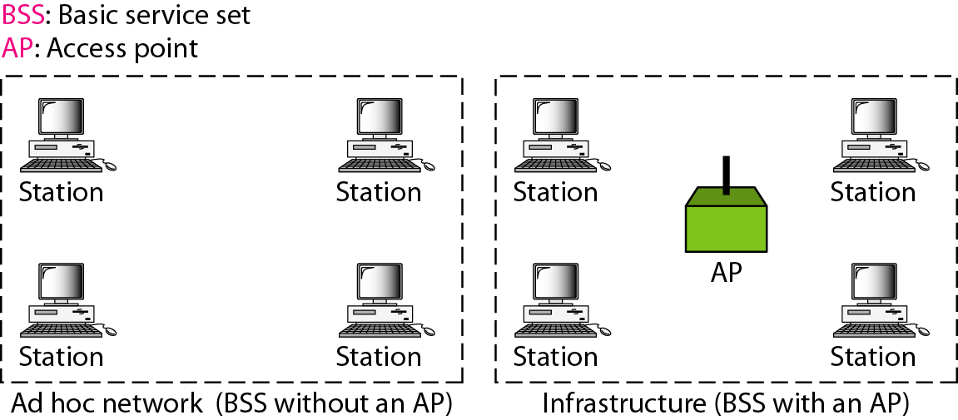
Basic service sets (BSSs)

Slide 5
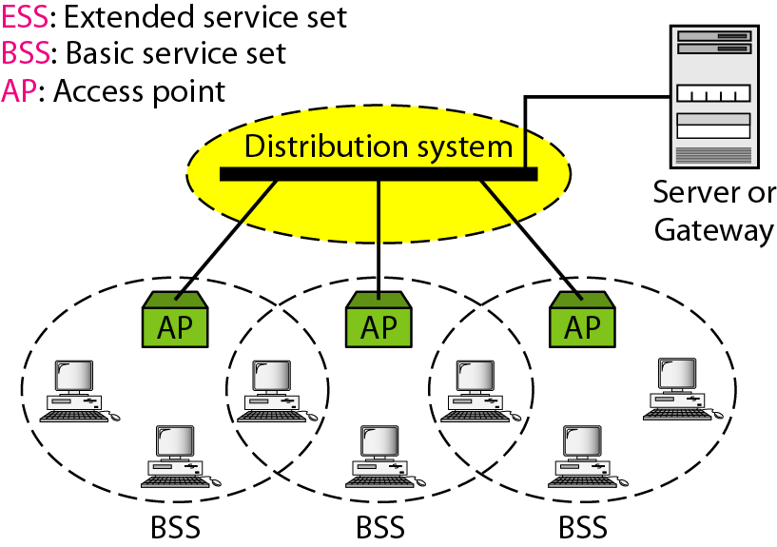
Extended service sets (ESSs)

Slide 6
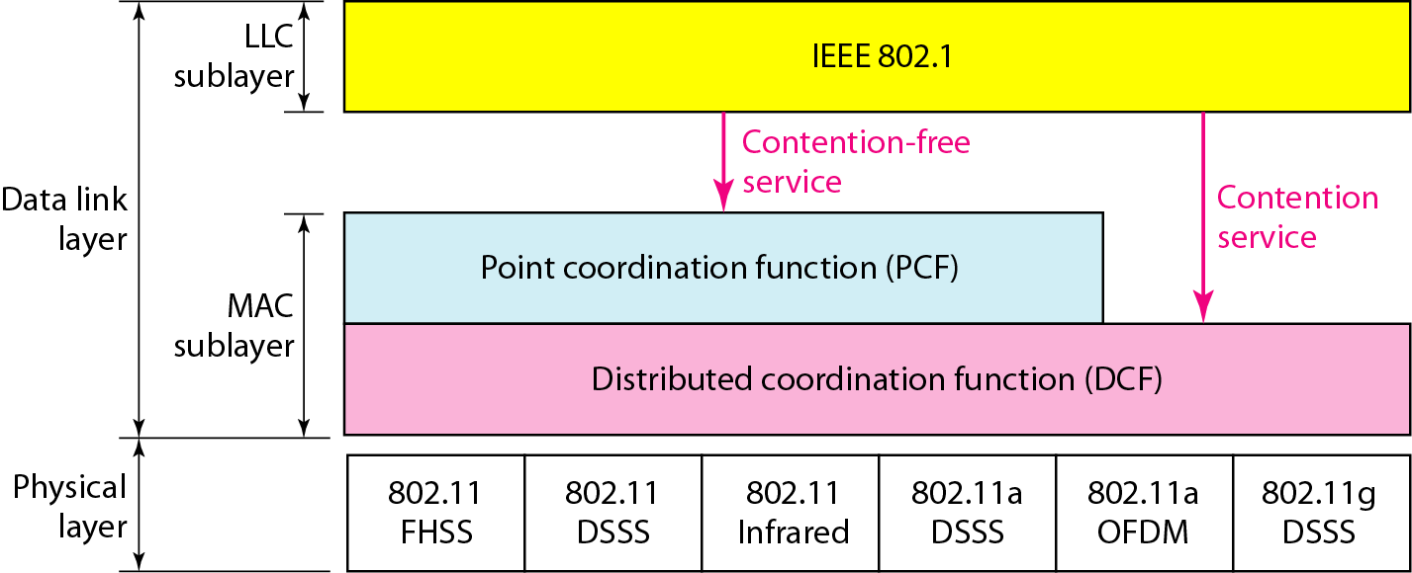
MAC layers in IEEE 802.11 standard

Slide 7
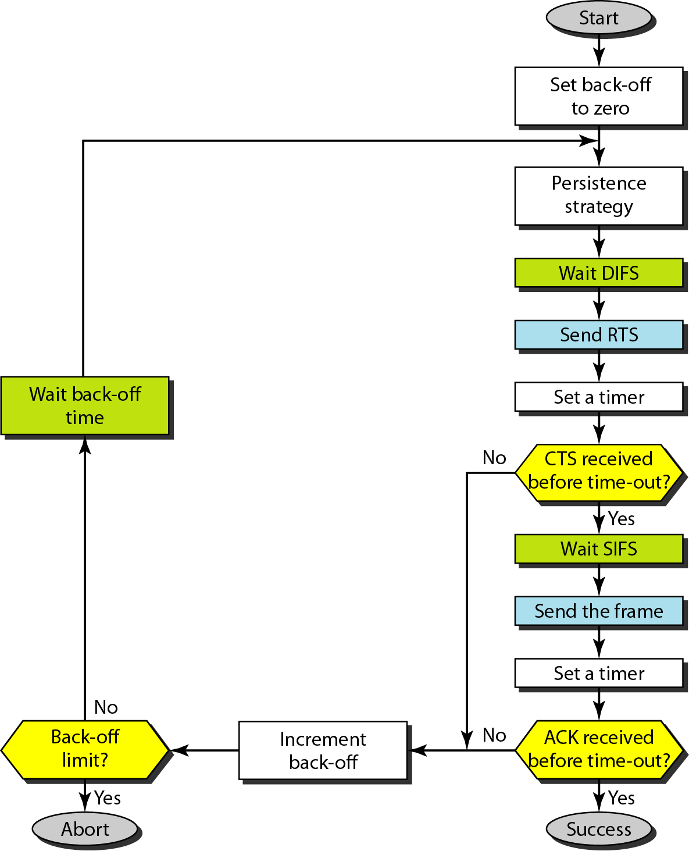
CSMA/CA flowchart

Slide 8
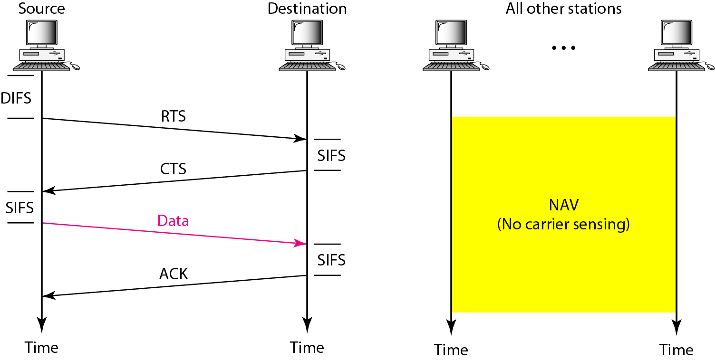
CSMA/CA and NAV

Slide 9
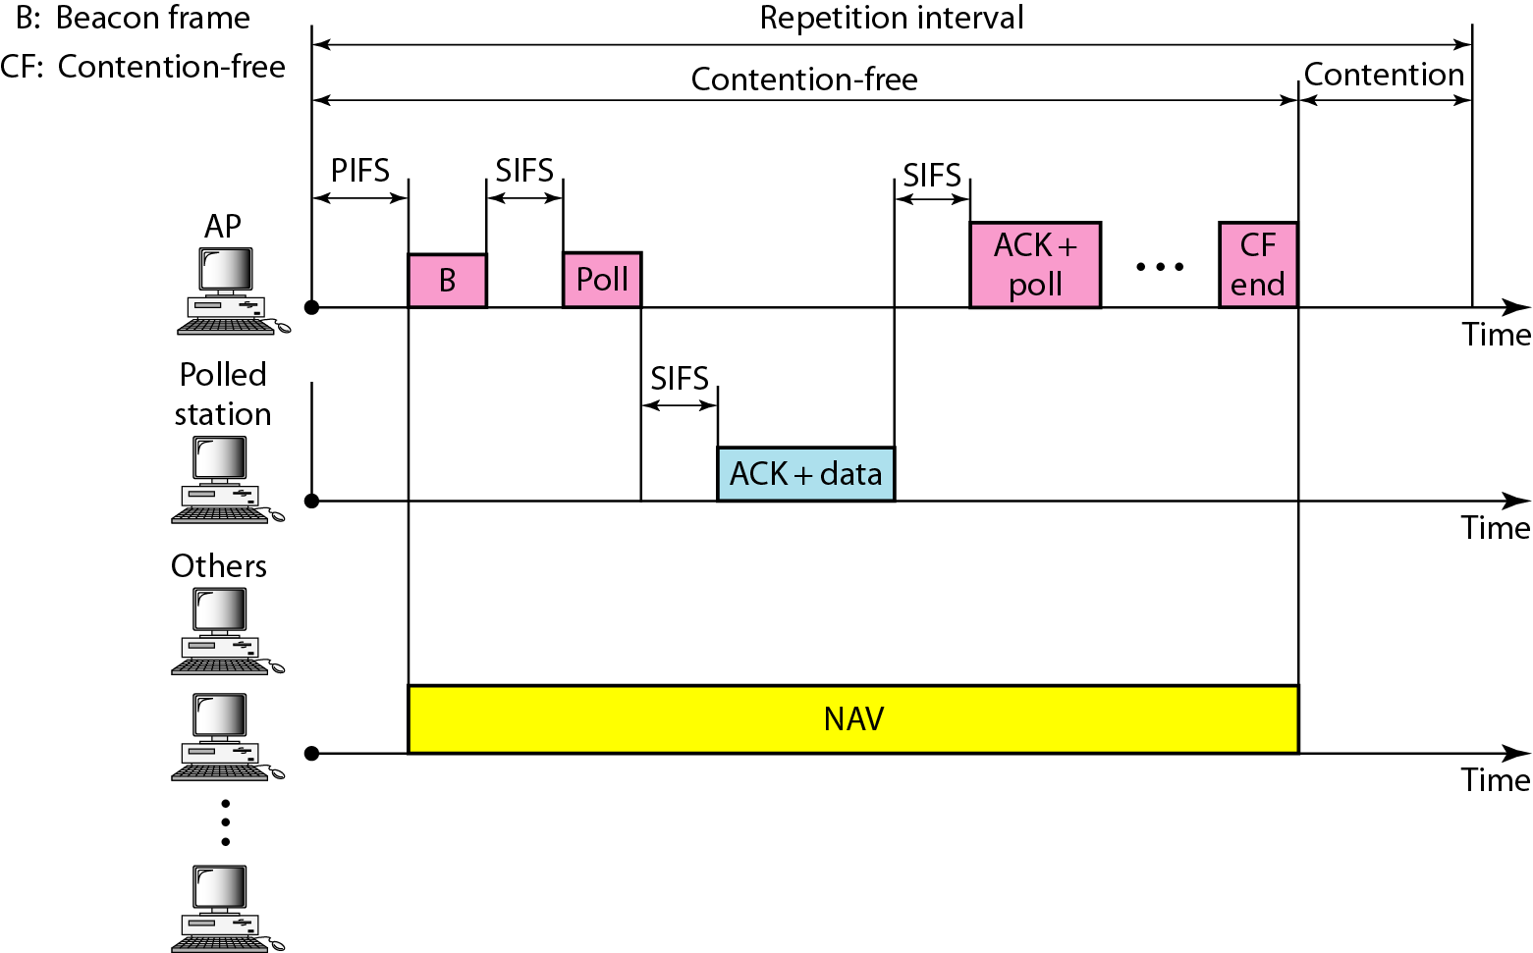
Example of repetition interval

Slide 10
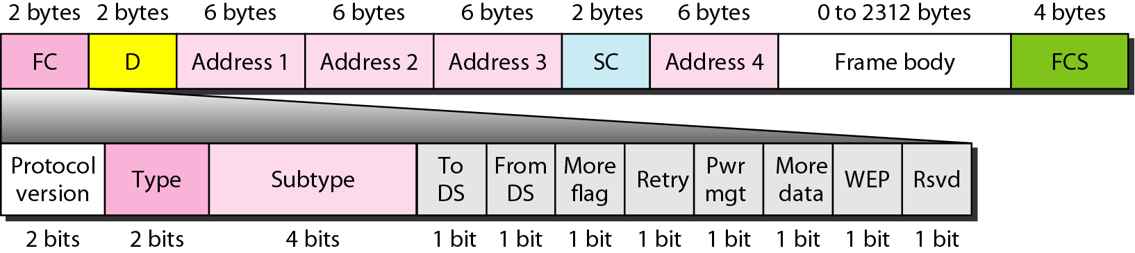
Frame format

Slide 11
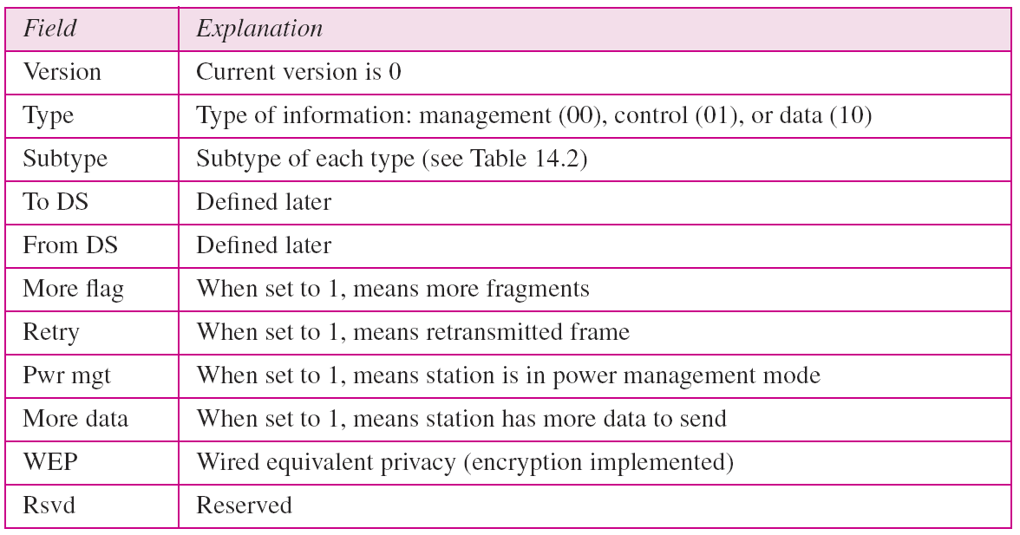
Subfields in FC field

Slide 12
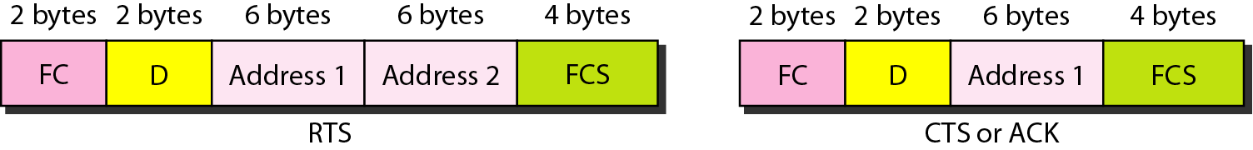
Control frames

Slide 13
Values of subfields in control frames

Slide 14
Addresses

Slide 15
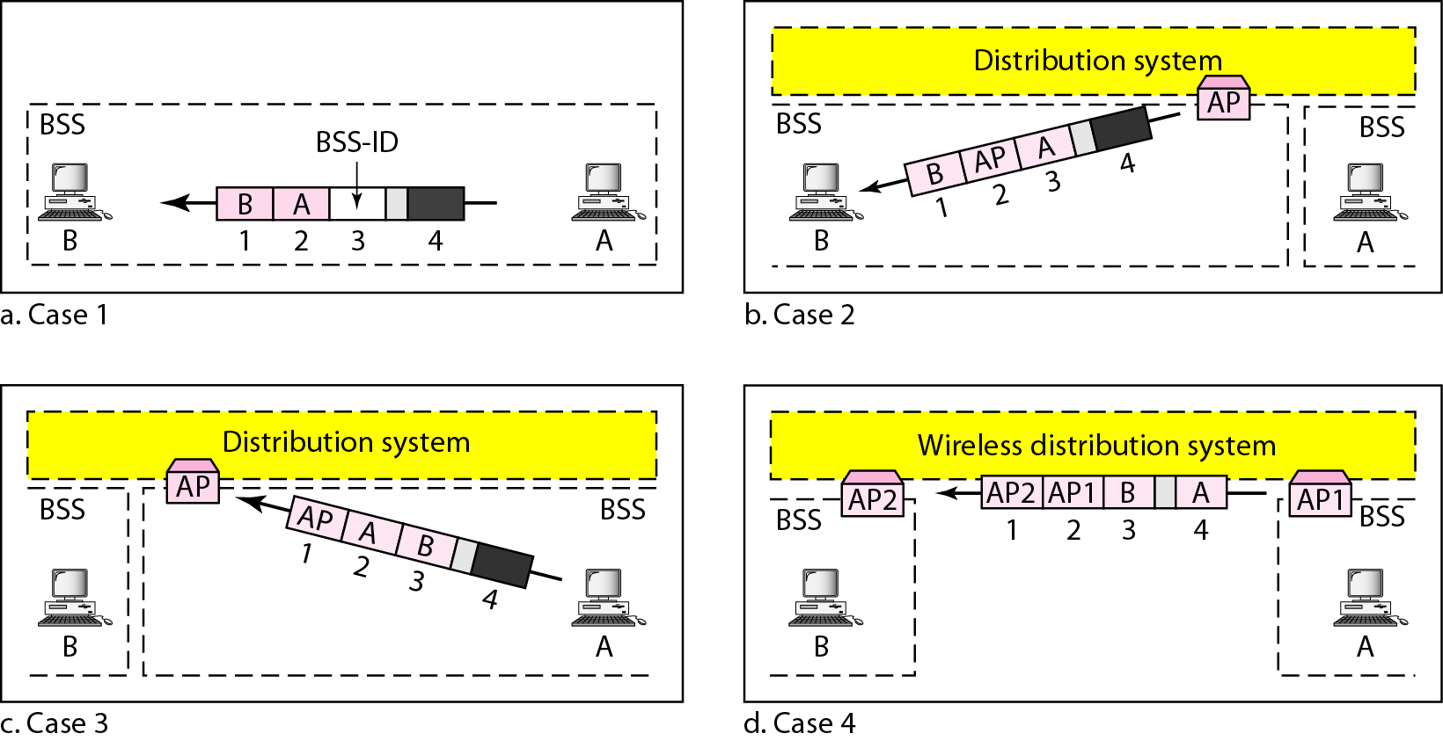
Addressing mechanisms

Slide 16
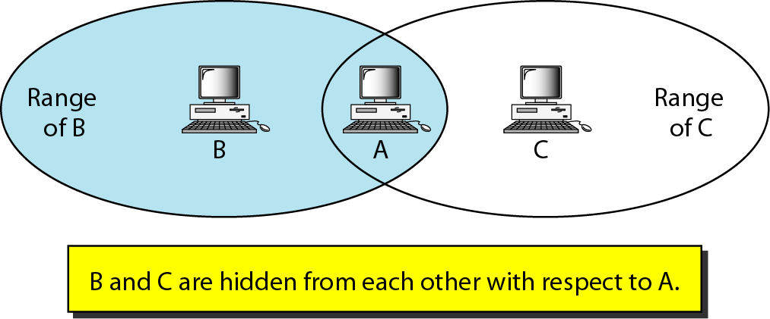
Hidden station problem

Slide 17
Note
The CTS frame in CSMA/CA handshake can prevent collision from a hidden station.

Slide 18
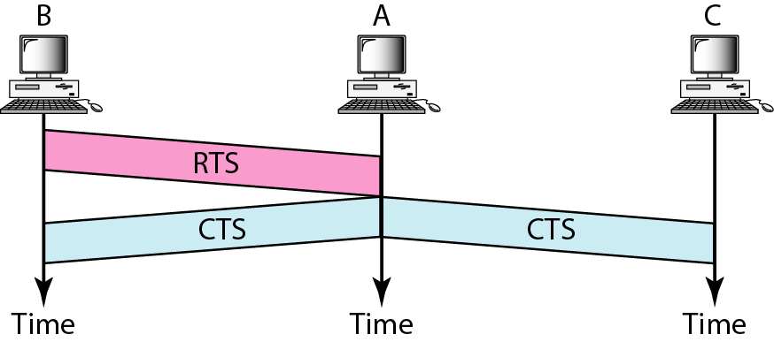
Use of handshaking to prevent hidden station problem

Slide 19
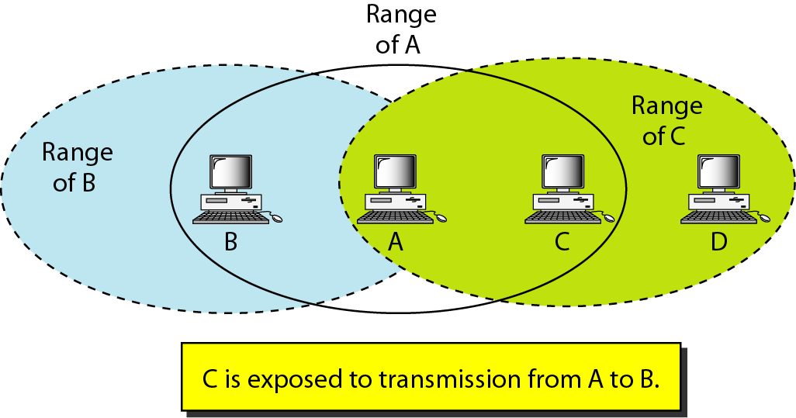
Exposed station problem

Slide 20
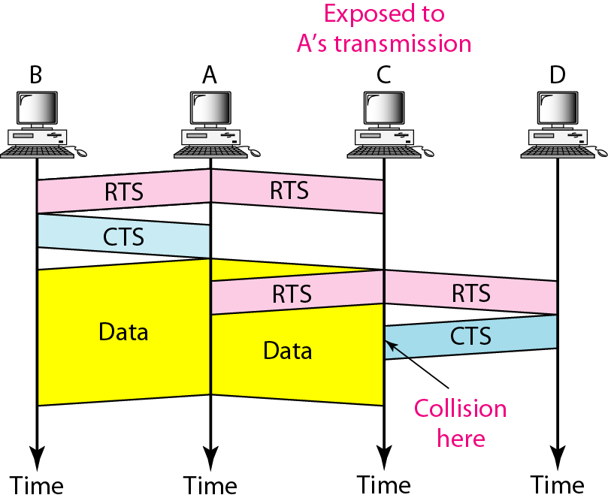
Use of handshaking in exposed station problem

Slide 21
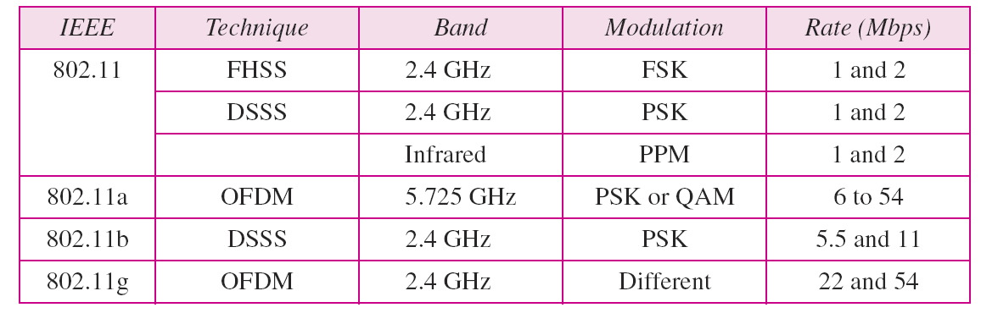
Physical layers

Slide 22
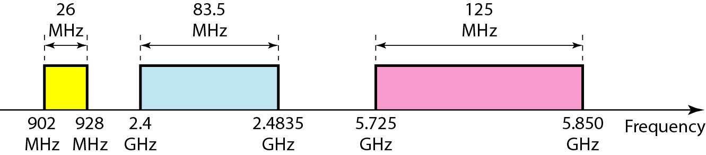
Industrial, scientific, and medical (ISM) band

Slide 23
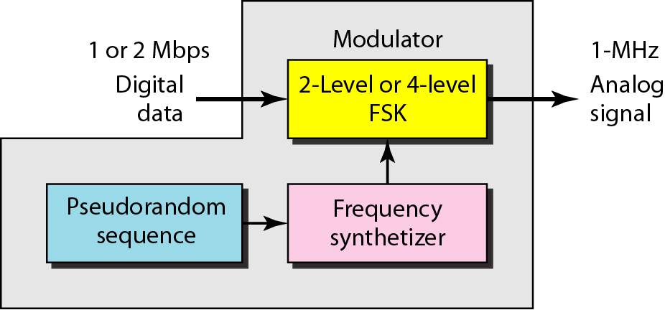
Physical layer of IEEE 802.11 FHSS

Slide 24
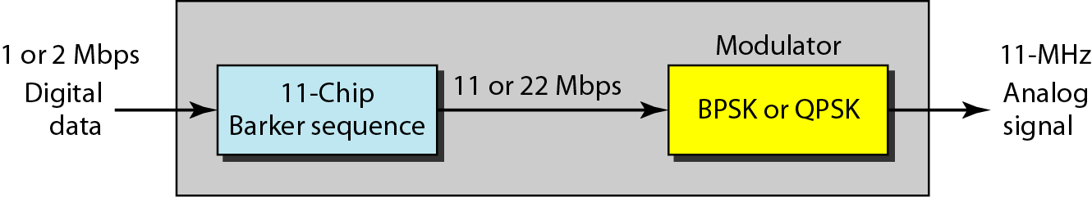
Physical layer of IEEE 802.11 DSSS

Slide 25
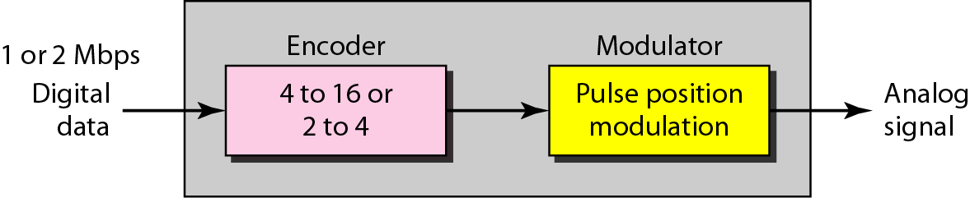
Physical layer of IEEE 802.11 infrared

Slide 26
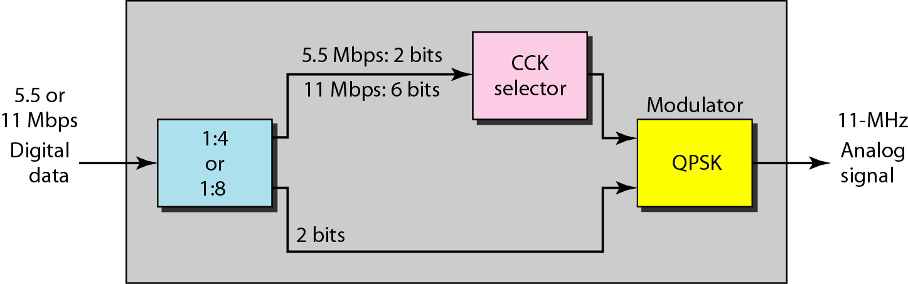
Physical layer of IEEE 802.11b

